Slide 1
EMAIL SPAM DETECTION
Team Member-1
Name: Aditya Kambala
Register No.: 192111130
Year: 2021-2025
Department: CSE
Institution: Saveetha School of Engineering
Team Member-2
Name : Munivardhan
Register No : 192110637
Year: 2021 -2025
Department : CSE
Institution: Saveetha School of Engineering

Slide 2
Introduction:
Spam emails can be not only annoying but also dangerous to consumers.
Spam emails can be defined as:
1. Anonymity
2. Mass Mailings
3. Unsolicited
Spam email are message randomly sent to multiple address by all sorts of groups, but mostly lazy advertisers and criminals who wish to lead you to phishing sites.

Slide 3
Rationale and Relevance:
Email Security: Spam email detection is directly related to ensuring the security of email communication systems. By accurately identifying and filtering out spam emails, email users are protected from various security threats such as phishing scams, malware distribution, and fraudulent activities.
User Experience: Spam email detection is relevant for improving user experience by reducing the clutter and distraction caused by unwanted emails in users' inboxes. By effectively filtering out spam emails, users can focus on important emails and enhance their productivity.
Data Privacy: Spam email detection plays a role in safeguarding users' data privacy by preventing unauthorized access to sensitive information through phishing attacks and other malicious activities conducted via email.

Slide 4
Abstract:
To control the spam email issues and resolve by classification
spam emails are thereat to use in several ways such as security risk and information over load
This research aims to develop an effective system for automatically detecting and filtering out spam emails from legitimate ones.
A diverse dataset containing a mixture of spam and legitimate emails is gathered from various sources, reflecting real-world email communication scenarios.
KEYWORDS: Spam email, Email classification, Spam detection, Email filtering

Slide 5
Objectives of the Project:
The objective of identification of Spam e-mails are:
To give knowledge to the user about the fake e-mails and relevant e-mails
To classify that mail spam or not.
Applications of the Project:
Mobile Applications:
Integration into mobile email applications to provide users with real-time spam detection and filtering capabilities on their smartphones and tablets.
Marketing Campaigns:
Utilization in marketing automation platforms to ensure that promotional emails comply with anti-spam regulations and are targeted effectively to legitimate recipients.

Slide 6
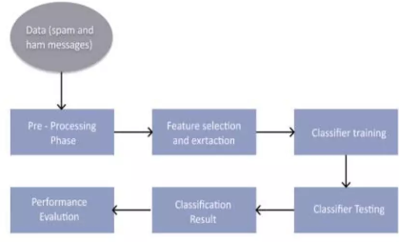
Procedures and Methodology:
Problem Definition and Scope
Data Collection and Preprocessing
Feature Extraction
Monitoring and Maintenance
Documentation and Reporting
Model Evaluation and Validation

Slide 7
Project Requirements
Hardware Requirements:
Processor : 11th Gen Intel(R) Core(TM) i5-11400F @ 2.60GHz
RAM : 8.0 GB or 16.0 GB
Storage Space : 100-150GB
Monitor : LCD
Internet : 4g/5g Internet or wifi
Mouse : wired or wireless
Software Requirements:
Packages- C programming, DEV C++
Windows 11 64-Bit OS
Operating system : 64-bit operating system and X64-based processor

Slide 8
Research and Analysis:
Data Collection and Analysis:
Researchers collect large datasets of emails, both spam, and legitimate, to analyze their characteristics and patterns. Data analysis involves understanding the distribution of features such as text content, metadata, and structural properties in spam and legitimate emails.
Real-Time Detection and Scalability:
Research addresses the challenges of real-time spam email detection and scalability, particularly in large-scale email systems.
Techniques for optimizing model inference speed and handling high-volume email traffic are explored.

Slide 9
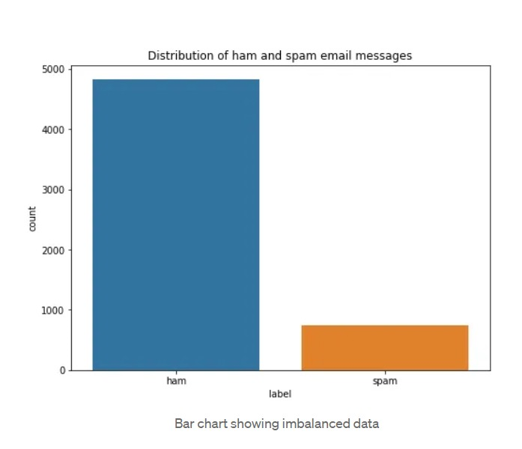
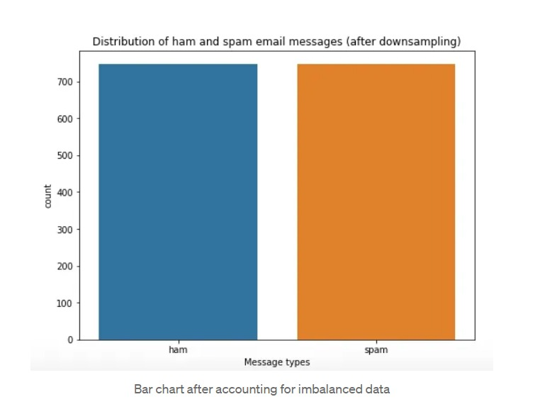
Evaluation of Outcomes/Results and Findings:
There are several ways to handle the imbalance data, for instance
use of appropriate evaluation metrics
Resembling the training set : oversampling/up sampling or under sampling/down sampling ensemble different resample datasets
Furthermore, on average, the ham message has length of 73 words whereas spam message has 138. The length information may be useful when we set maxlen parameter later.

Slide 10
Conclusion and Future Work:
We are able to classify the emails as spam or non-spam. With high number of emails lots if people using the system it will be difficult to handle all possible mails as our project deals with only limited amount of corpus.
It provides sensitivity to the client and adapts well to the future spam techniques.
It considers a complete message instead of single words with respect to its organization.
It increases Security and Control.
It reduces IT Administration Costs.
It also reduce Network Resource Costs.
.

Slide 11
Bibliography:
Clemmer. A. (2012). How Bayesian algorithm works. [online] Availableat: https://www.quora.com/How-do-Bayesian algorithms-work-for-the- identification-of-spam [Accessed 16 Aug, 20171.
What is Email Spam". (2017). [Blog] comm100. Available at: https://emailmarketing.comm 100.com/email-marketing-cbook/email- spam.aspx [Accessed 27 Aug. 20171.
G. He, Spam Detection. 1st ed. 2007.
bot2, V. (2017). Email Spam Filtering A python implementation with scikit-learn. [online] Machine Learning in Action. Available at:https://appliedmachinelearning.wordpress.com/2017/01/23/email-spam- filter-python-scikit-learn/ [Accessed 30 Aug. 2017].

Slide 12
Appendix:
#include <stdio.h>
#include <string.h>
int main() {
char email[1000];
int spamCount = 0;
// Get input email
printf("Enter the email content: ");
fgets(email, sizeof(email), stdin);
// Check for spam keywords
if (strstr(email, "win") != NULL || strstr(email, "lottery") != NULL || strstr(email, "free") != NULL) {
spamCount++;
}
// Determine if email is spam or not
if (spamCount > 0) {
printf("Spam email detected!\n");
} else {
printf("Legitimate email.\n");
}
return 0;
}

